Slide 1
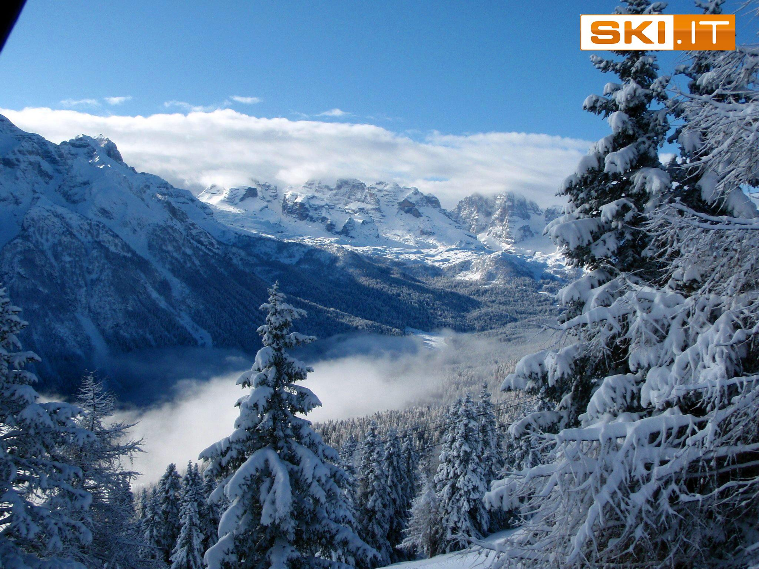
SAFETY ON THE SLOPES

Slide 2
WHY ALL THE RULES?
The following rules have been formulated for all practitioners of this wonderful sport for the same reason as the Highway Code.
If we all do it the same way, we will all know what to expect in given situations, and we will all be happier, more relaxed and safer.
We offer these safety guidelines, in line with the recommendations by the FIS (International Ski Federation) Rules for Conduct, as responsible ski tour operators and as a contribution to the safety of everybody on the piste.

Slide 4
RESPECT FOR OTHERS
All slope users must behave in such a way that they do not endanger others nor harm them by their behaviour or how they use their equipment.

Slide 5
CONTROL OF SPEED & BEHAVIOUR
All slope users must adapt their speed and behaviour to their personal capabilities as well as to the general conditions of the slope, weather, snow conditions, and density of other slope users at the time

Slide 6
CHOICE OF ROUTE/DIRECTION
Slope users who are higher up the slope are in a position which enables them to choose their trajectory. They must always make this choice in a way that they do not endanger the slope users below.

Slide 7
OVERTAKING
Overtaking may take place above or below, but must always be undertaken with sufficient space to take into account the movement of the slope user being overtaken.

Slide 8
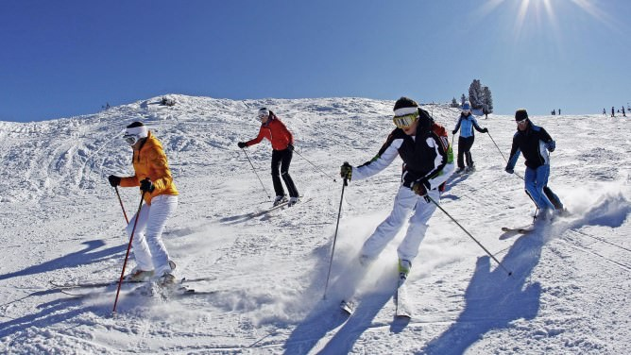

Slide 9
ENTERING, STARTING OFF FROM AND CROSSING SLOPES
When entering and starting off from or crossing slopes, all slope users must visually check uphill and down to ensure that they can do so without endangering themselves or other slope users.

Slide 10
STOPPING
All slope users must avoid stopping in narrow places or areas of restricted visibility. In the event of a fall, they should remove themselves from the slope as quickly as possible.

Slide 12
WALKING UP OR DOWNHILL
Any slope user who is obliged to move up or downhill on foot must keep to the side of the slope and ensure that neither they nor their equipment endangers other slope users.

Slide 13
RESPECT FOR INFORMATION, SIGNS & SIGNPOSTING
All slope users must respect slope information concerning weather conditions, the conditions of the slopes, and of the snow. They must respect signs at all times.

Slide 14
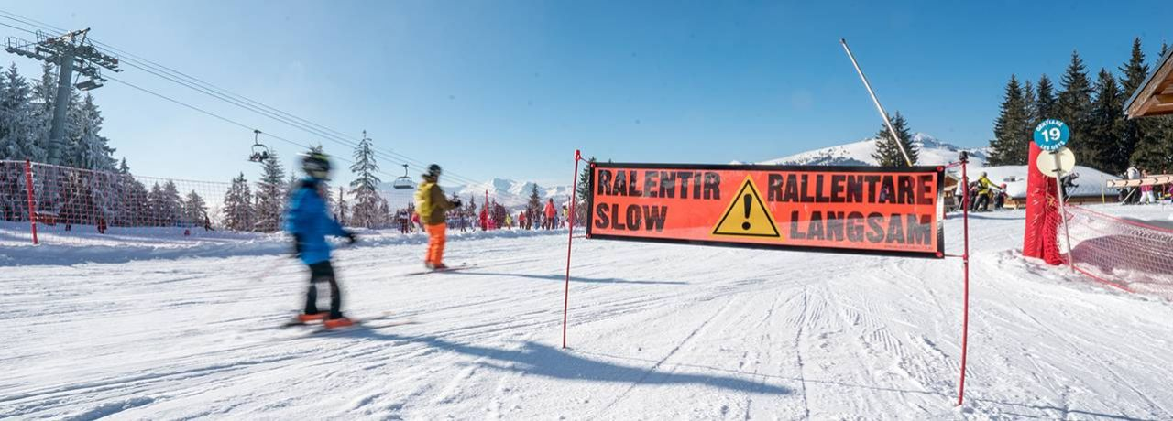

Slide 15
ASSISTANCE
Any person who is a witness or instigator of an accident must give assistance, in particular by raising the alarm. Should the need arise, and at the request of the mountain rescue service, must place themselves at their disposal.

Slide 16
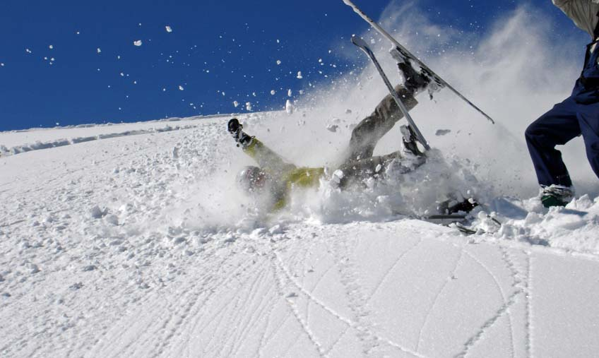

Slide 17
IDENTIFICATION
Any person who is involved in, or witness to, an accident must identify themselves to the Piste Patrol, as well as to any others involved in the accident.

Slide 18
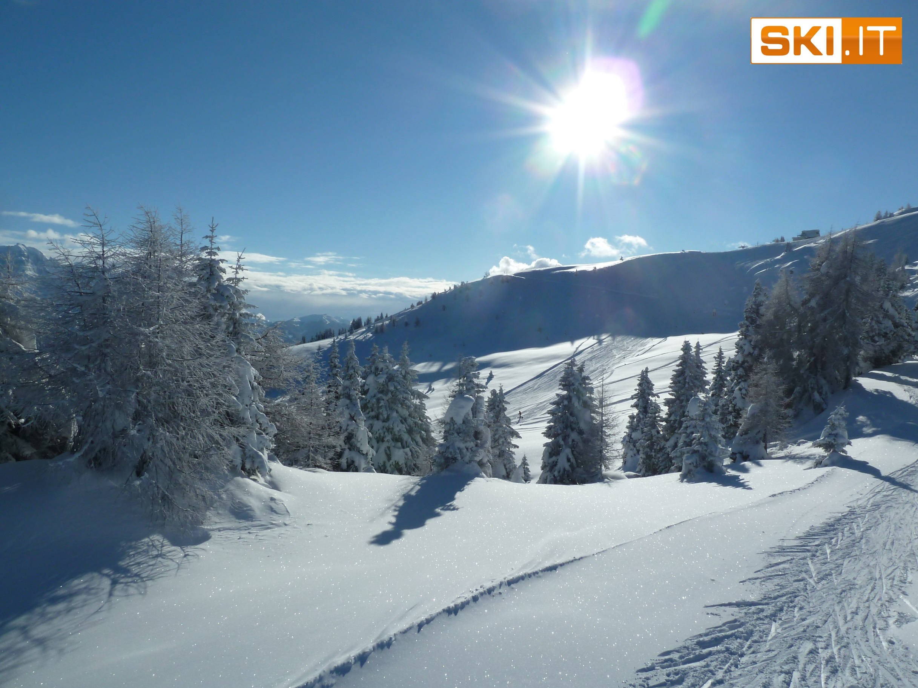
SAFTEY ON THE SLOPES – THE SKIWAY CODE

